Slide 1
SALES DASHBOARD
D Balaji
11805130
K18UW

Slide 2

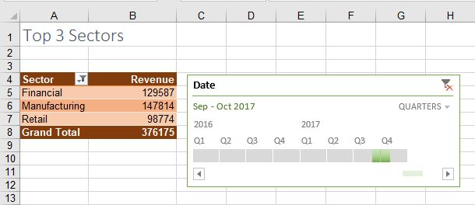
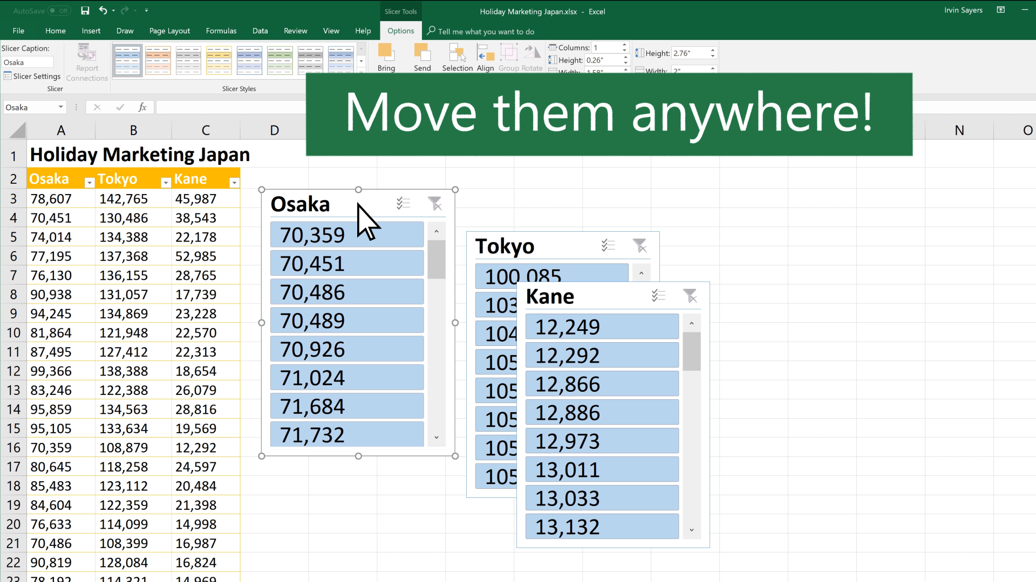
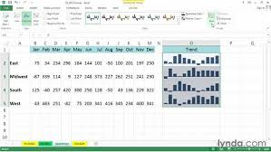
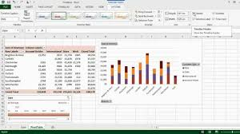
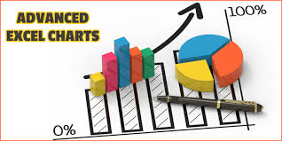
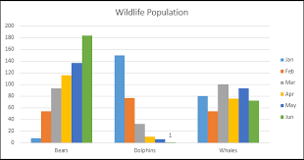
Sales Dashboard
Tools used
Slicers
Pivot tables
Timeline
Sparklines
Design Tools
Pivot Charts
Line chart
Bar chart
Area chart
Column chart
Pie chart

Slide 3
INTRODUCTION
The Excel Dashboard is used to display overviews of large data tracks.
Excel Dashboards use dashboard elements like tables, charts, and slicers to show the overviews.
The dashboards ease the decision-making process by showing the vital parts of the data in the same window.
Dashboards make work simple and makes easier to work with data.

Slide 4
Implemented Objectives
Displaying top 5 products sold considering the sales value (line chart)
Displaying sales value trend by brand and showing percentage of each products import with the total imports (combo chart- Bar and line)
Displaying units value trend by region and showing the average of imports in those region (combo chart-column and area)
Displaying imports trend by customer Industry and showing count of units value (combo chart- line and column)
Displaying top 5 countries that are importing more (Bar chart)

Slide 5
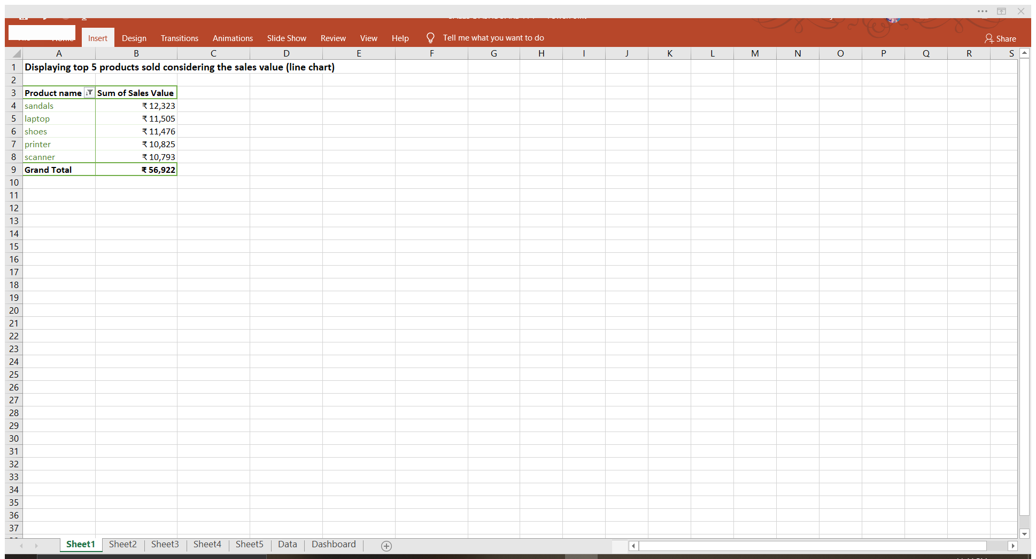
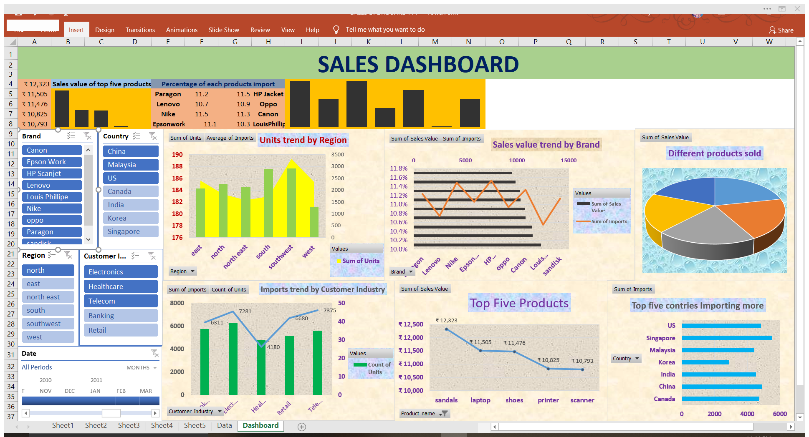
Objectives and the results
Objective 1: Displaying top 5 products sold considering the sales value (line chart)
Pivot Table
Pivot Chart

Slide 6
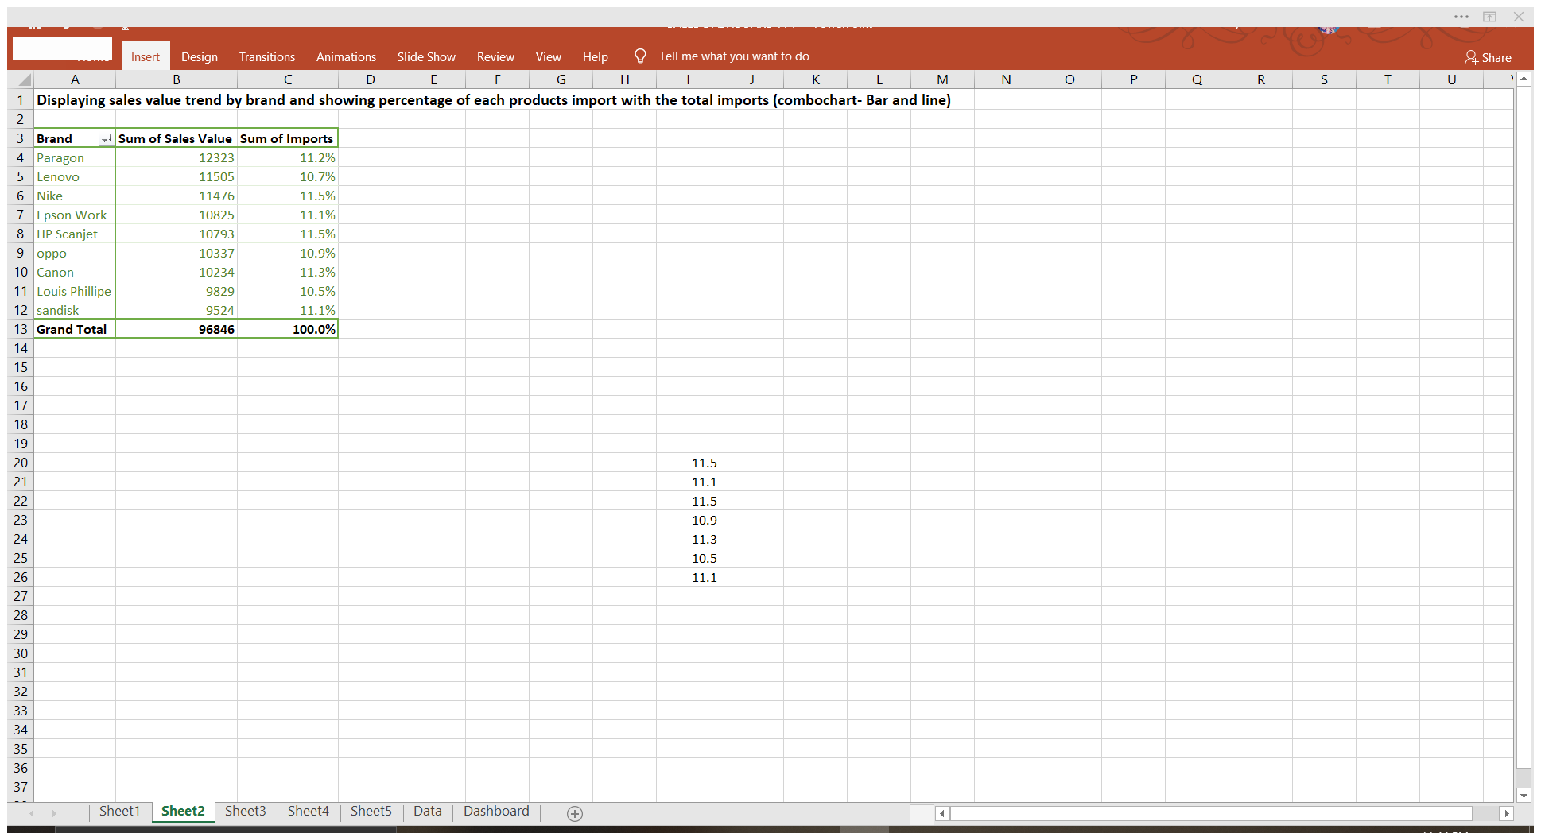
Objectives and the results
Objective 2: Displaying sales value trend by brand and showing percentage of each products import with the total imports (combo chart- Bar and line)
Pivot Table
Pivot Chart

Slide 7
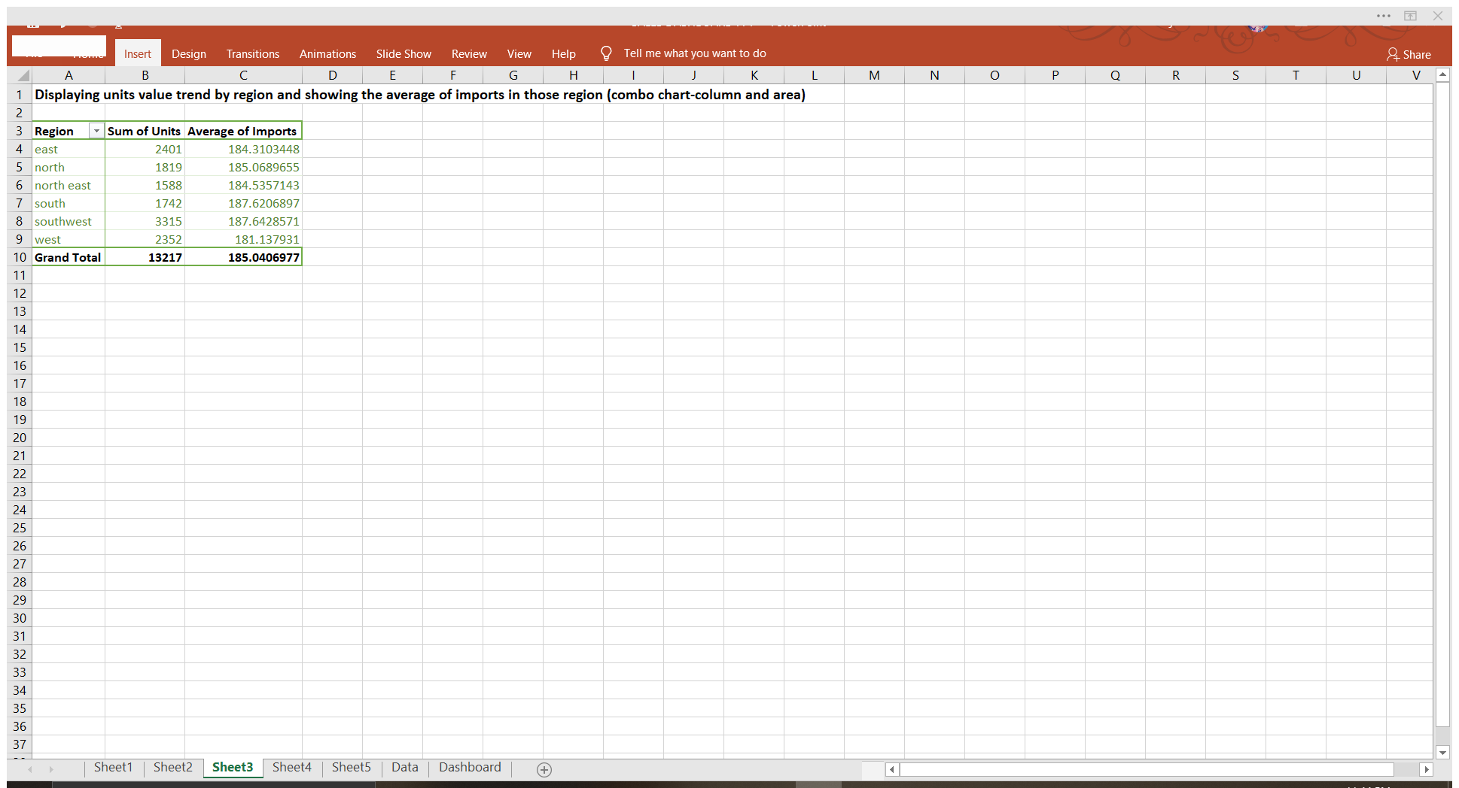
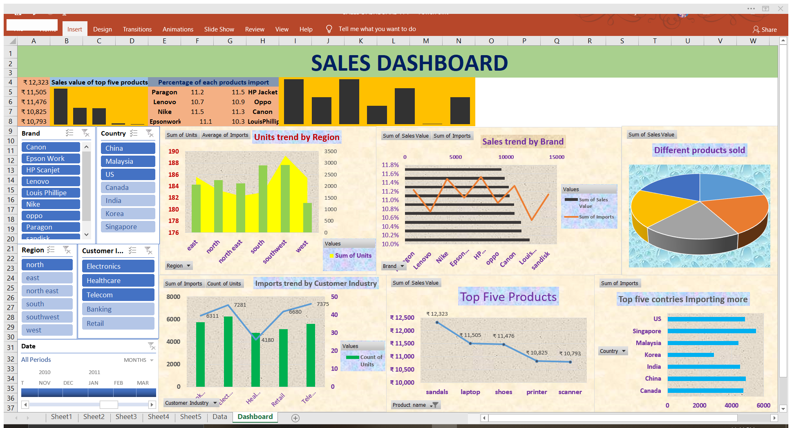
Objectives and the results
Objective 3: Displaying units value trend by region and showing the average of imports in those region (combo chart-column and area)
Pivot Table
Pivot Chart

Slide 8
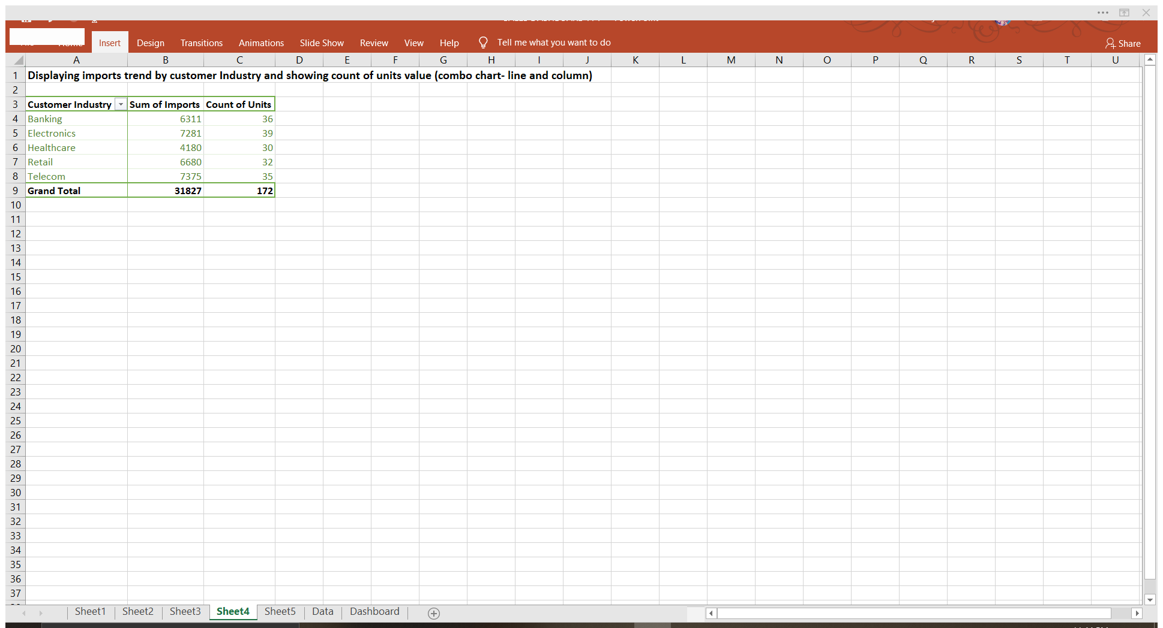
Objectives and the results
Objective 4: Displaying imports trend by customer Industry and showing count of units value
(combo chart- line and column)
Pivot Table
Pivot Chart

Slide 9
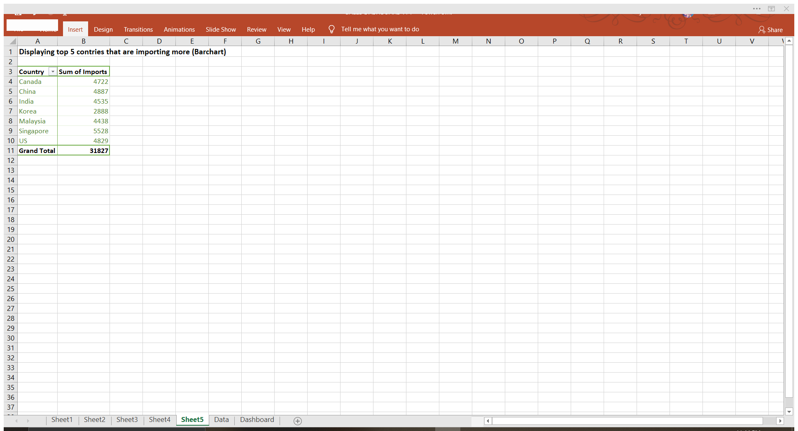

Objectives and the results
Objective 5: Displaying top 5 countries that are importing more (Bar chart)
Pivot Table
Pivot Chart

Slide 10

Slicers
Timeline
Sparklines

Slide 11
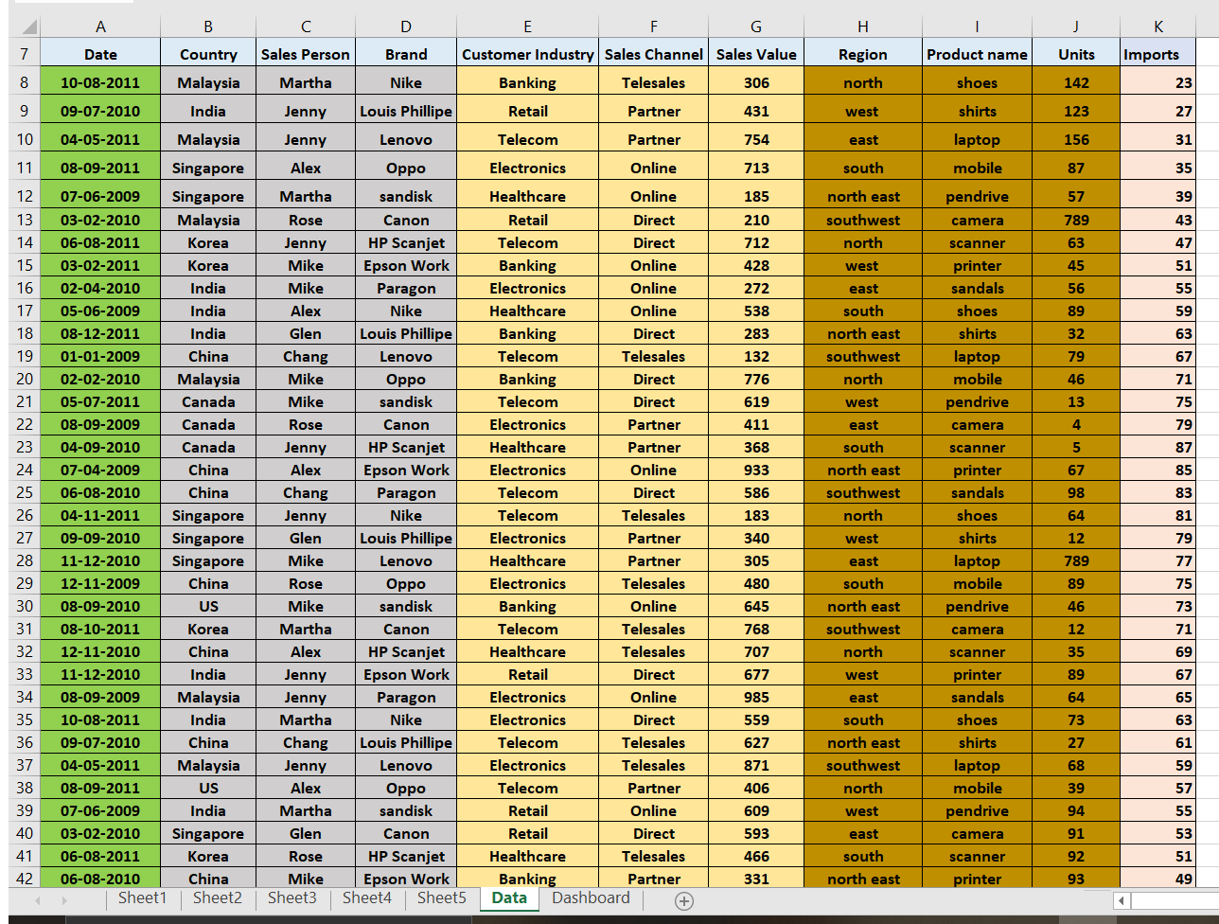
DATASET USED FOR THE IMPLEMENTATION OF THE DASHBPARD
ATTRIBUTES USED IN DATASET
Date
Country
Sales Person
Brand
Customer Industry
Sales Industry
Sales Value
Region
Product name
Units
Imports

Slide 12
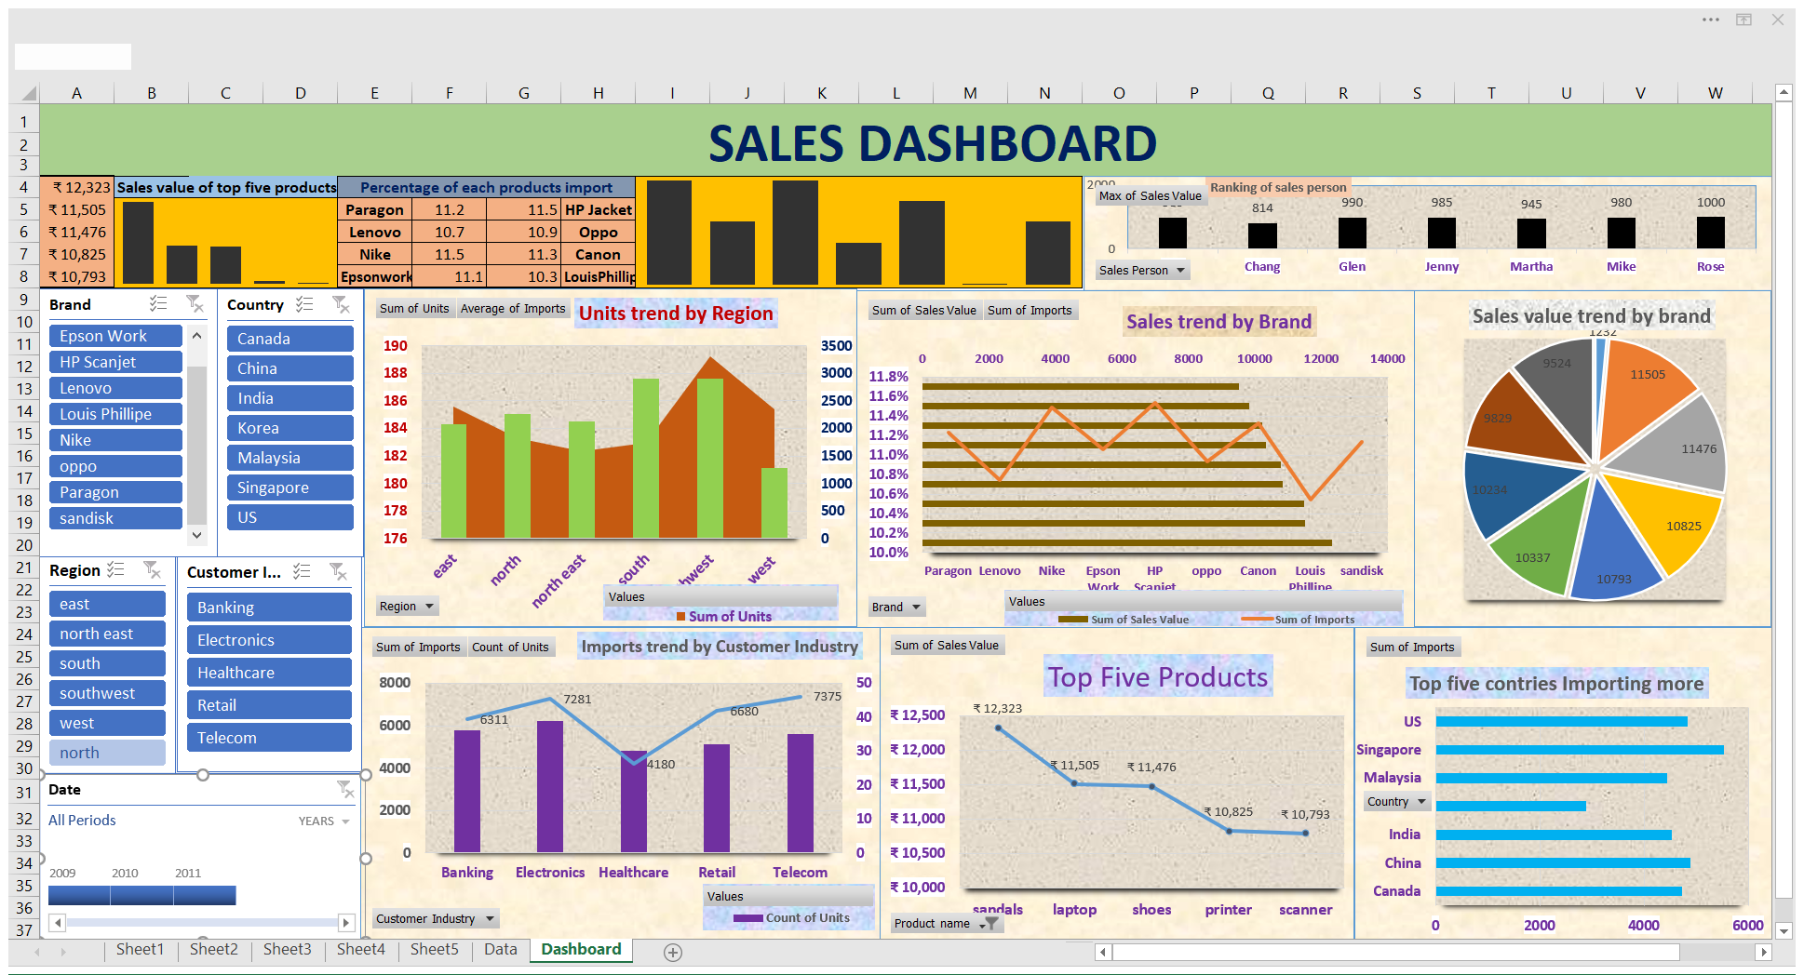

Slide 13
LEARNINGS
As we used slicers in the project it makes work easy , when we want to know the sales done in particular state on all the required dates.
It makes easy to take averages and calculate with the help of pivot charts.
Dashboard works with large amount of data and it makes user to understand easily because of its visualisation.

Slide 14
CONCLUSION
The Excel Dashboard is used to display overviews of large data tracks
Excel Dashboards use dashboard elements like tables and charts to show the overviews
The dashboard ease the process by showing the vital parts of the data in the same window

Slide 15


